Slide 1
Territory-wide System Assessment
5 October 2015
Dr Lam Ling Chi, Tenny
General Manager-
Education Assessment Services Division

Slide 2
Enhancement Measures (April 2014)
Not to disclose BC attainment rates for primary schools in individual school reports;
To delete TSA results from the criteria for evaluations of school performance;
To extend the P.6 opt-in alternate-year arrangement, i.e. the P.6 TSA will be implemented in odd-numbered years; and
To optimize TSA reporting functions by providing a more interactive downloading platform
To review the assessment design

Slide 3
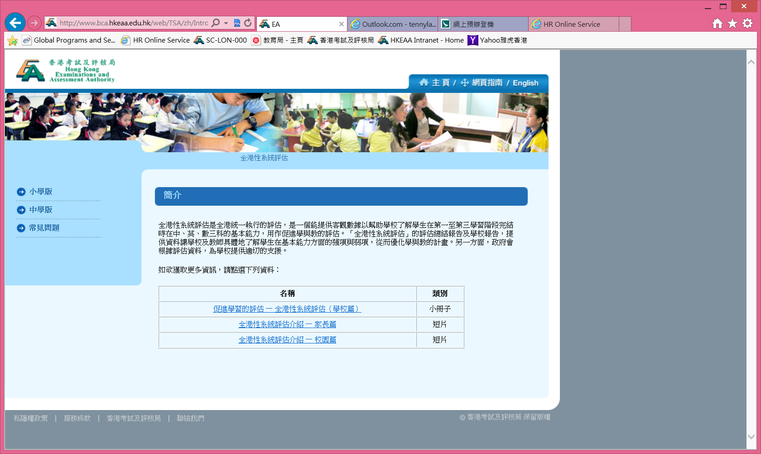
Communication via BCA website
www.bca.hkeaa.edu.hk-school/parent/leaflet

Slide 4
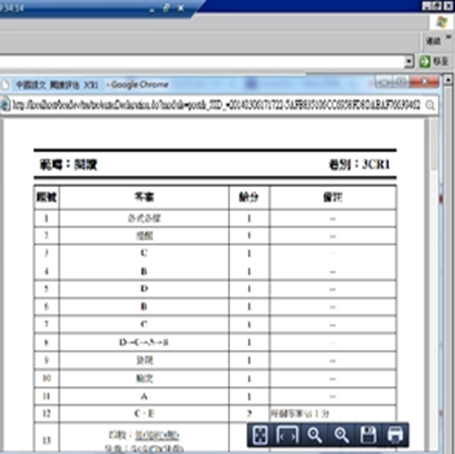
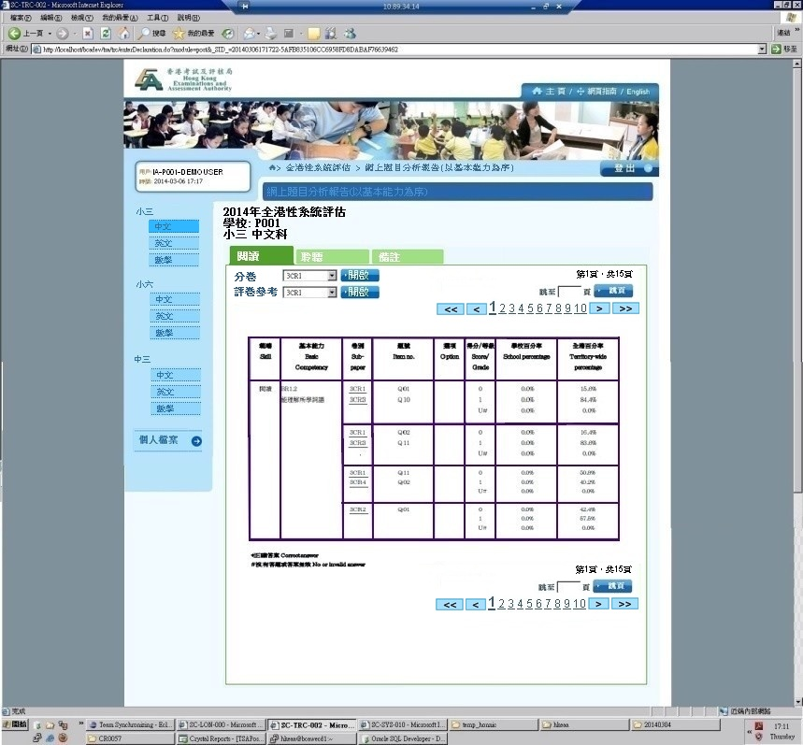
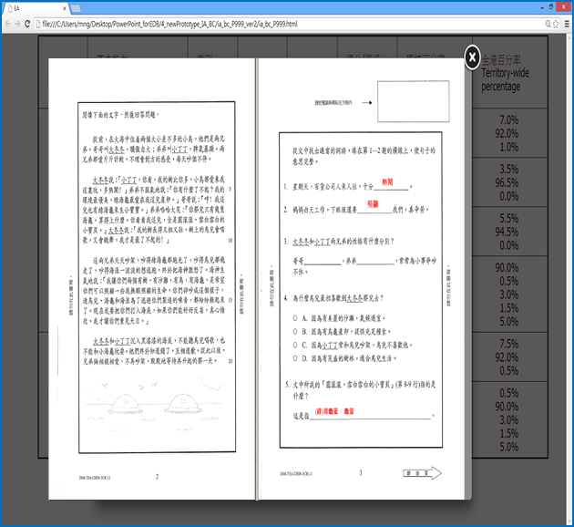
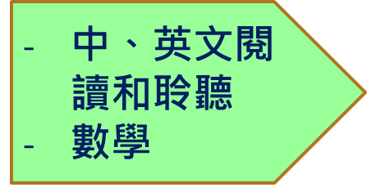
HKEAA- 2014.9.18 Seminar
Online Item Analysis (OIA) Report platform (phase 1) launched in Nov 2014
More functions/information for OIA Report platform (phase 2) launched in Nov 2015

