Slide 1
Overview of TSA
5nd October, 2015

Slide 2
Development in 2015
Phase 2 of Online Item Analysis Report
Support Google Chrome web browser
Interface with WebSAMS for student upload

Slide 3
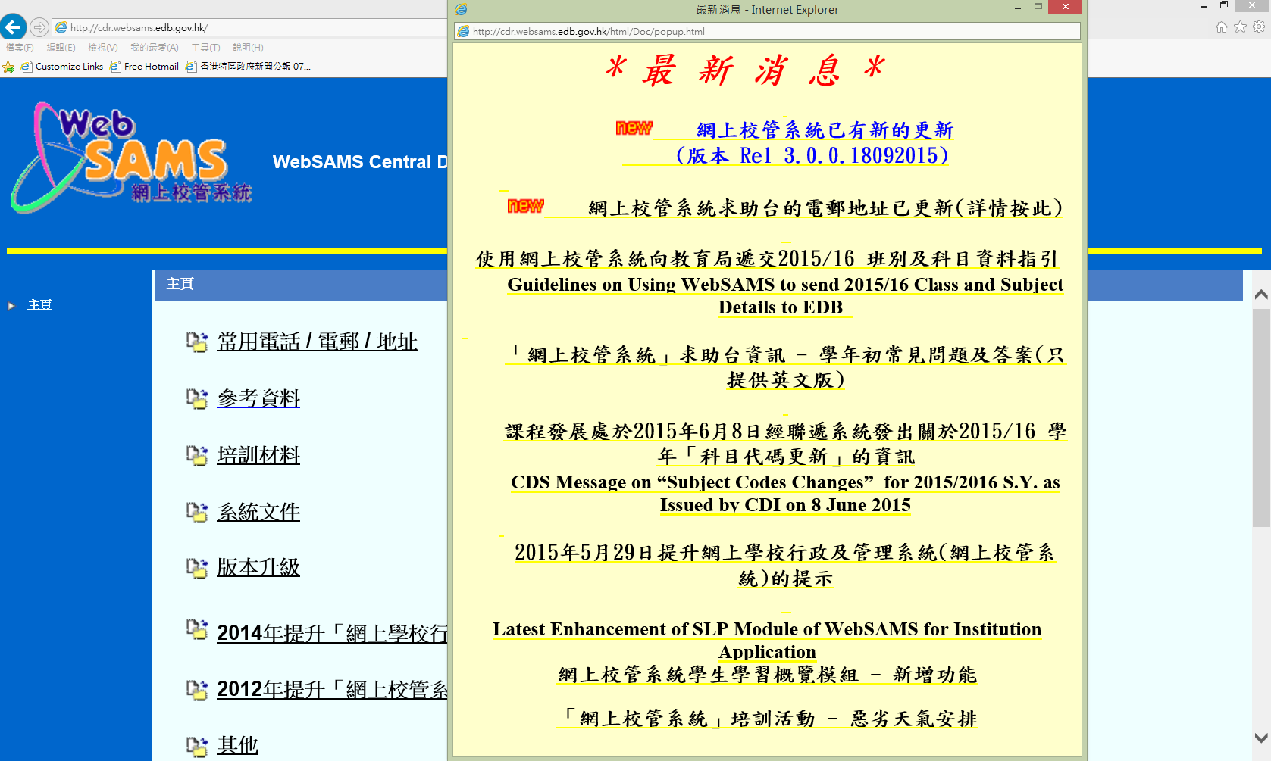
Interface with WebSAMS
Briefing on Submission of School Data (mid-Nov)
WebSAMS new build number

Slide 4
Online Item Analysis Report
Reports for TSA Result Release
Online Item Analysis Report
Demo of Teacher accounts
Demo of Management accounts

Slide 5
Reports for TSA Result Release
School Report
Supplementary School Report
Item Analysis Report
PDF version
Excel version

Slide 6
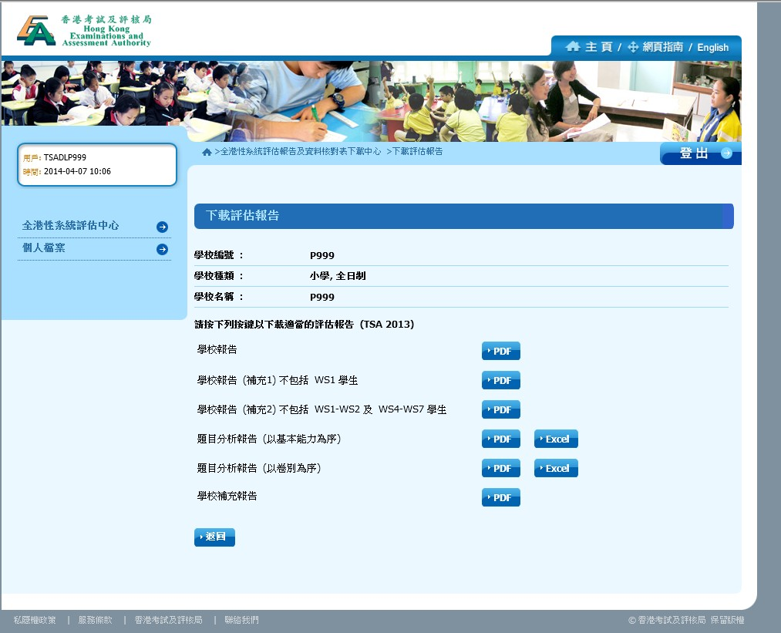
Online

Slide 7
Online Item Analysis Report
Interactive platform where teachers can obtain statistical information to facilitate learning and teaching

Slide 8
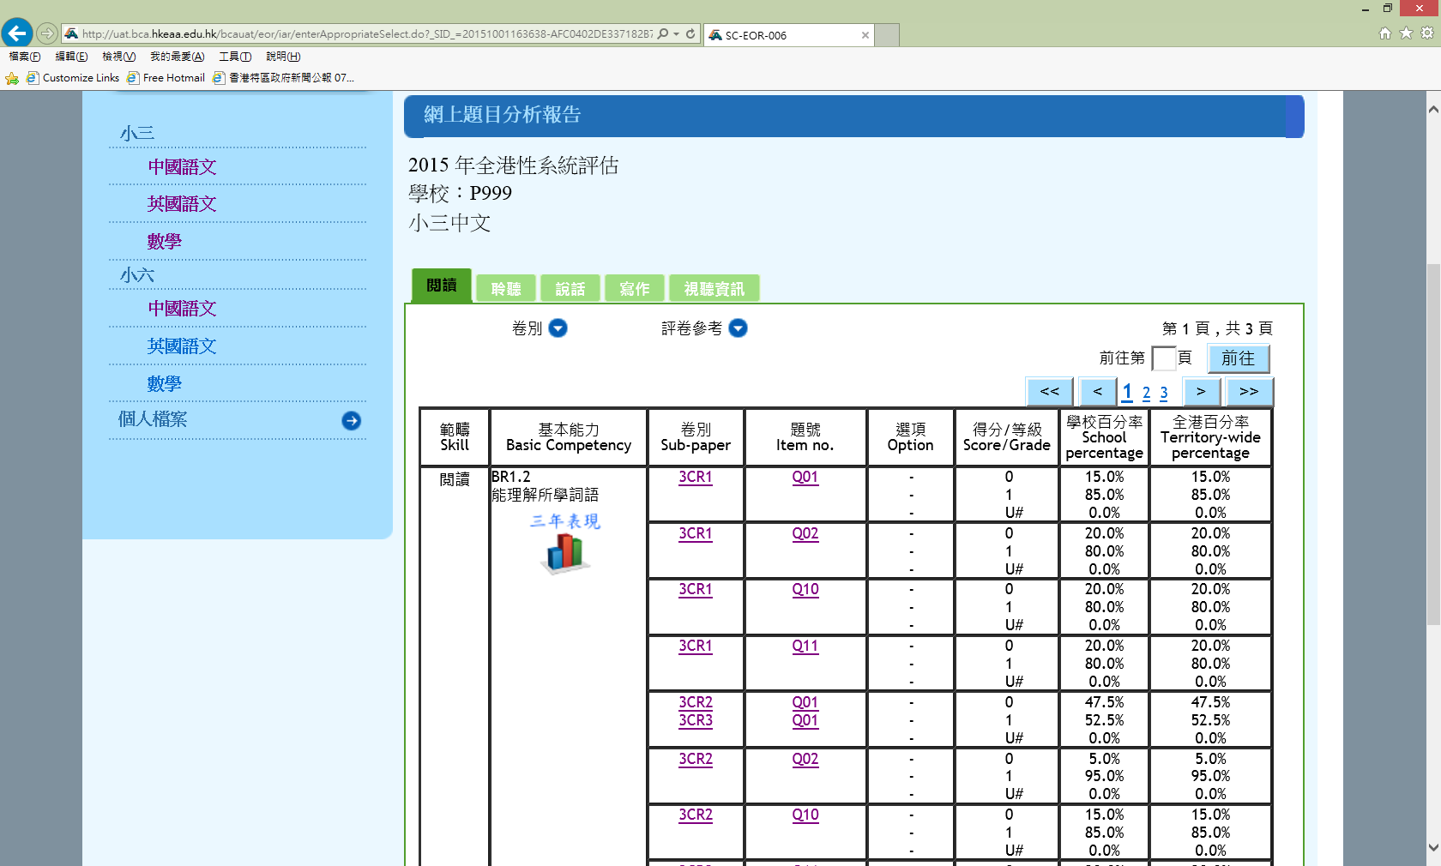

Slide 9
Online Item Analysis Report
New features in 2015
Display of individual questions (with Answers)
Dimension of Writing, Speaking, and
Chinese Audio Visual (CAV)
Exemplar of Writing
Question Intent of English Language
Three years’ Performance

Slide 10
Online Item Analysis Report
Open Period:
From the Release of TSA results
To End of June the following year
Management (School head) account
Schools manage their own Teacher accounts
Max 60 Teachers accounts per school
Teacher accounts carried over to the following TSA year
Teacher accounts
Based on subject-levels (e.g. P3 English)

Slide 11
Online Item Analysis Report
Dimension
Chinese Language:
閱讀、聆聽 + 寫作、說話、視聽資訊
English Language:
Reading, Listening + Writing, Speaking
Mathematics:
e.g. 數、度量、圖形與空間

Slide 12
Demo of Teacher accounts
Introduction to the Online Item Analysis Report
How teachers use their accounts to view the report

Slide 13
Demo of Management account
Login
Prepare Teacher accounts for a new year
Enable/Disable a Teacher account
Change the Privilege of Teachers (subject level)
Add Teacher accounts
Delete a teacher account
Password management
Auto-unlock mechanism
Reset password for a teacher
Search Teacher accounts
Edit account information

Slide 14
Demonstration

Slide 15
Thank you!

